Slide 1
Mumbai Vs Kolkata
Battle of Neighbors

Slide 2
Comparing Mumbai and Kolkata
Evaluation done based on population changes in between these two cities in from 1950-2019
Price Change analysis of Houses
Trending Places in two places
Climate changes in between these two cities over last few years

Slide 3
Challenge of Data
To start with the analysis, finding actual data was very challenging
No ready data available in any website
For data collection, I have searched everywhere possible
Based on my finding, I came with this analysis

Slide 4
Data References
Population and Area data for Mumbai and Kolkata : https://en.wikipedia.org/wiki/List_of_metropolitan_areas_in_India
Mumbai Area Information https://github.com/rajibkrsarkar/The-Battle-of-Neighborhood/blob/master/MumbaiPC.csv
Kolkata Area Information https://github.com/rajibkrsarkar/The-Battle-of-Neighborhood/blob/master/KolkataPC.csv
Kolkata Climate Data : https://en.wikipedia.org/wiki/Kolkata#Rainfall
Mumbai Climate Data : https://en.wikipedia.org/wiki/Mumbai#Climate
Colleges and Universities in Kolkata along with Degrees offered :https://en.wikipedia.org/wiki/Universities_and_colleges_of_West_Bengal
Mumbai All College and List :https://github.com/rajibkrsarkar/The-Battle-of-Neighborhood/blob/master/Mumbai_Updated-All-College-List-with-Course-Detailss.pdf
HPI data from https://data.gov.in/node/113600/download

Slide 5
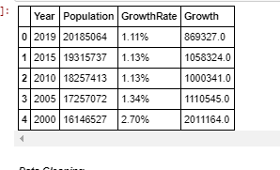
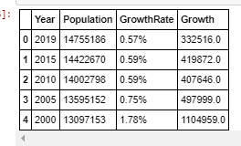
Data Clean up
Applied data wrangling strategies to cleanup the data I have collected to make it ready for my analysis
Mumbai Population
Kolkata Population

Slide 6
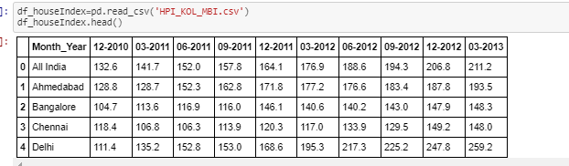
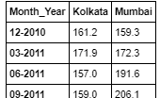
Data Cleanup
HPI Data of India
After Cleanup

Slide 7
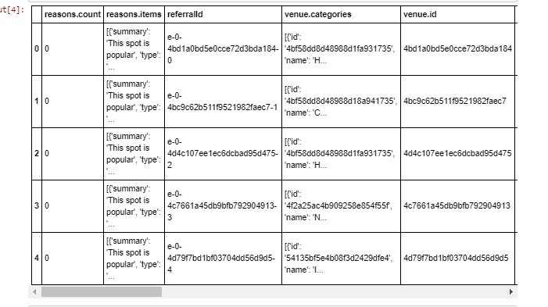
Data Cleanup
Collected Trend data via Foursquare

Slide 8
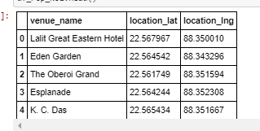
Data Cleanup
Cleanup Trend data

Slide 9
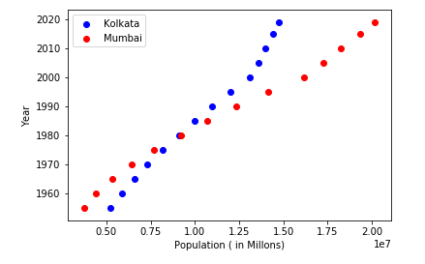
Population Data Analysis
The population growth rate of Kolkata is higher than Mumbai

Slide 10
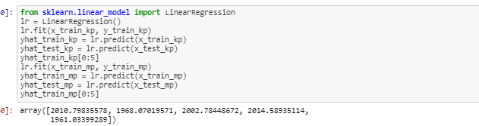
Applying Liner Regression to predict
Based on my understanding I applied Liner regression to find the prediction of population growth for both cities

Slide 11
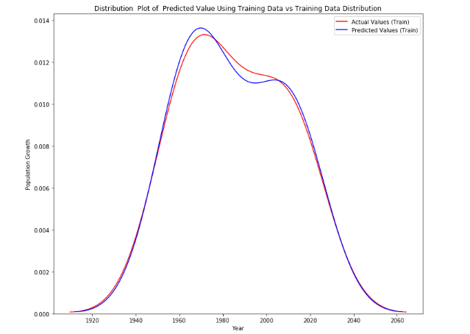
Population Prediction

Slide 12
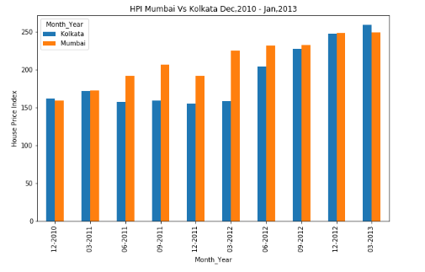
House Price Index Compare
Comparing House Price Index : Mumbai vs Kolkata

Slide 13
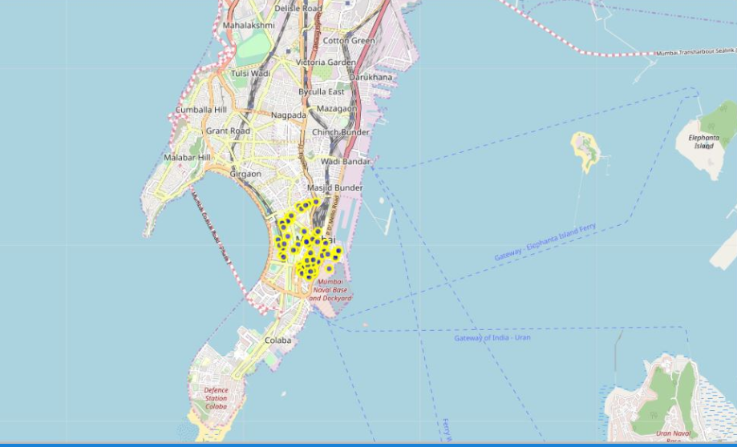
Trending Places in Mumbai

Slide 14
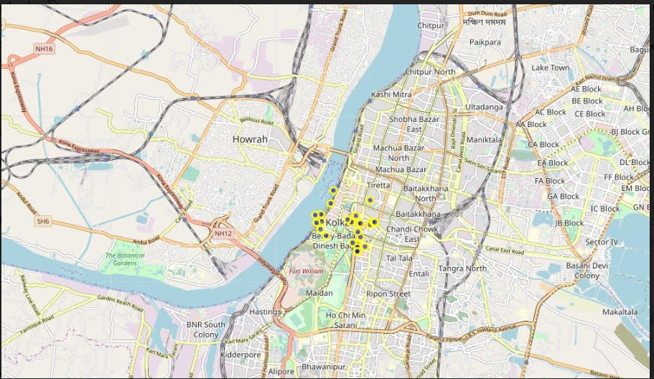
Trending Place in Kolkata

Slide 15
Conclusion
Kolkata has more population growth rate has increased than Mumbai but the total population of Mumbai is more than Kolkata
House price index of Mumbai is more than Kolkata
Mumbai has more trending places than Kolkata

